Slide 1

Bahir-Dar Institute of Technology Faculty of computing Department of computer Science
Implementation on
Title: Android Based Taxi Booking And Ordering System

Slide 2
System functionalities
Both passenger and driver need to be registered.
After registration, they are allowed to login.
After passenger is logged in, he/she can see the near by taxi and press the book now button by providing destination place.
The Driver either accepts or rejects the request.
If s/he accepts the request name,phone,destination of passenger is forwarded to it.
Admin manages taxi, driver and can see booking transaction and set commission.

Slide 3
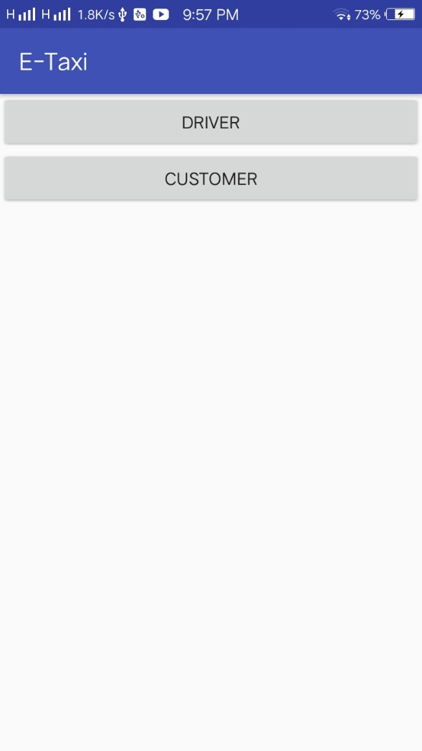
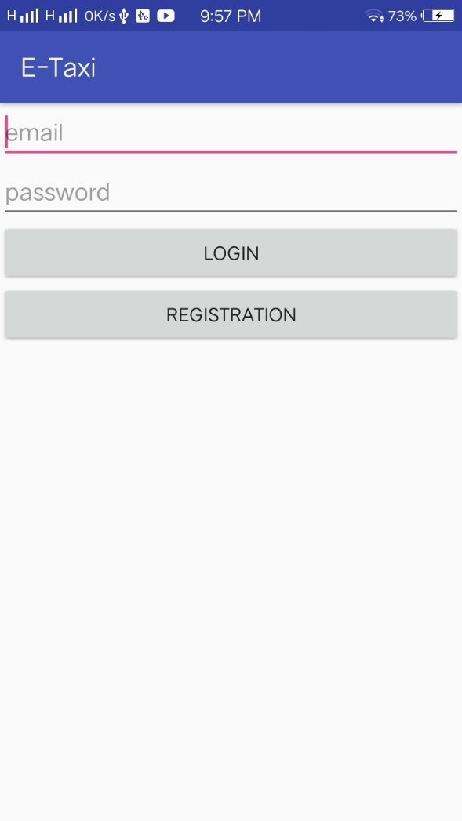
Application home page

Slide 4
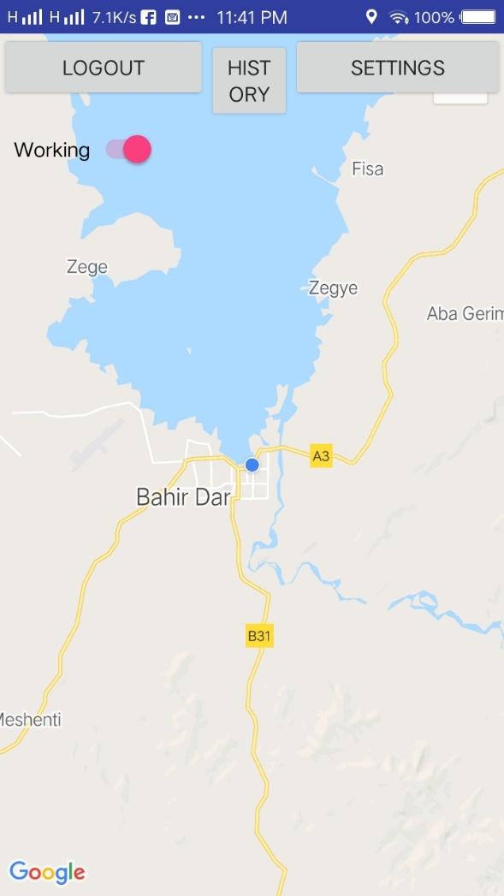
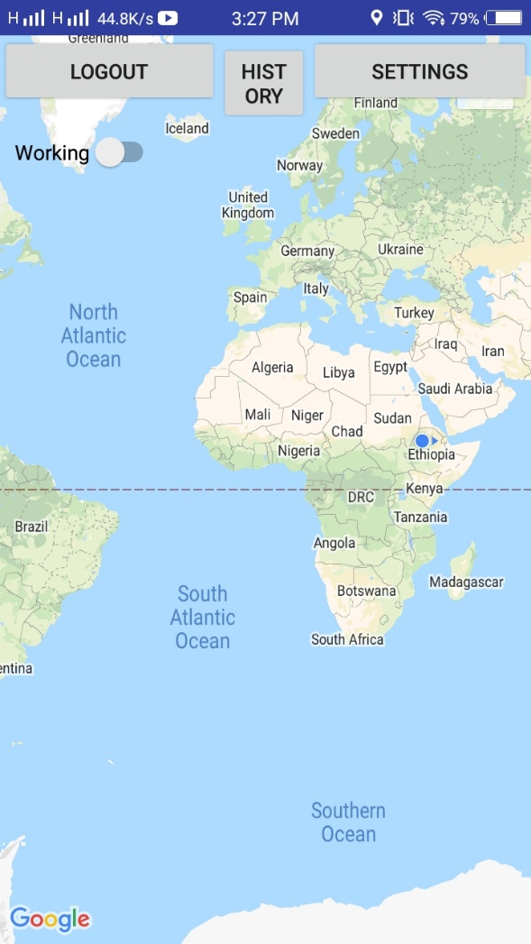
Driver page

Slide 5
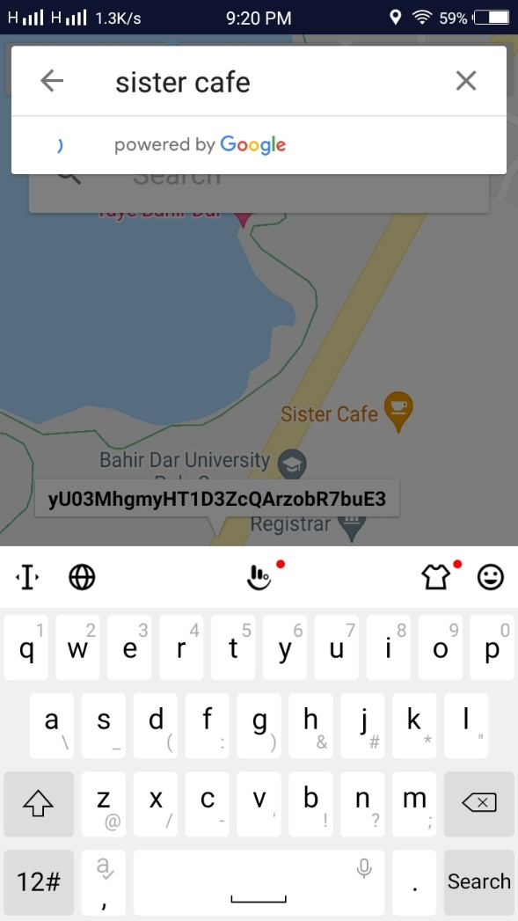
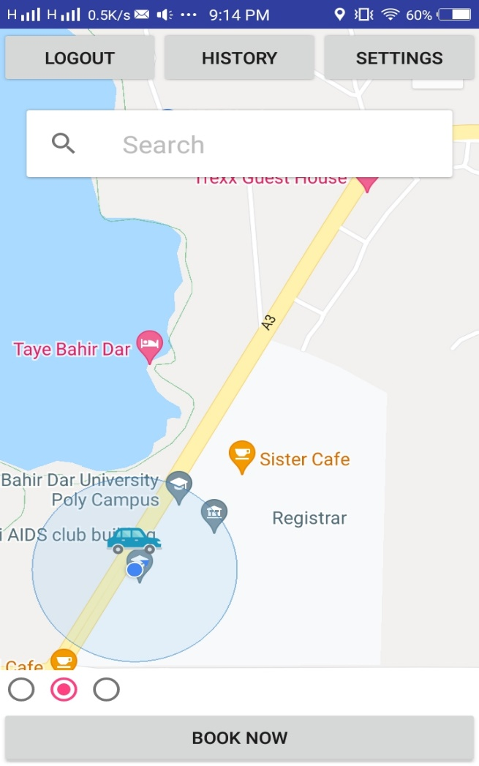
Passenger page

Slide 6
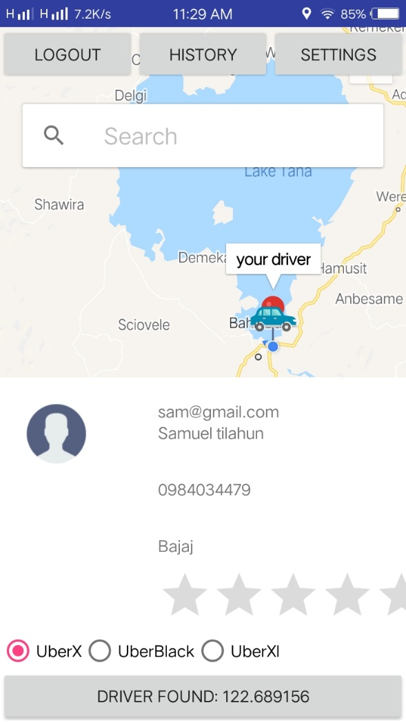
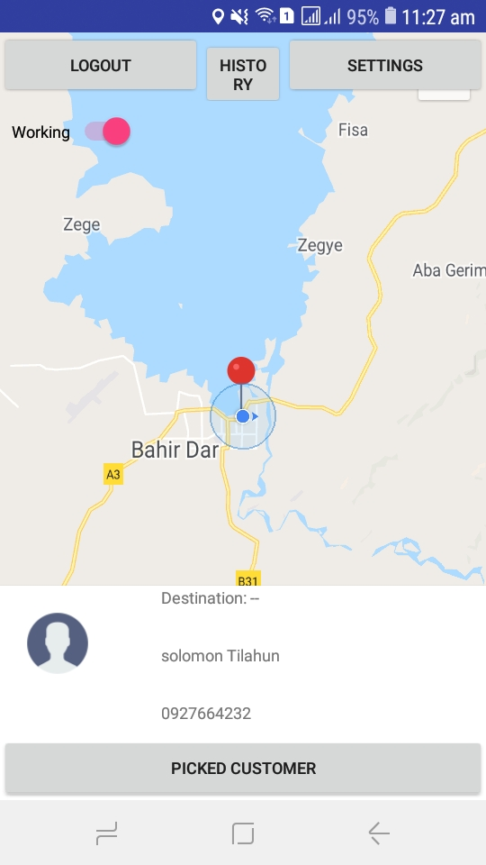
After passenger clicks book now button

Slide 7
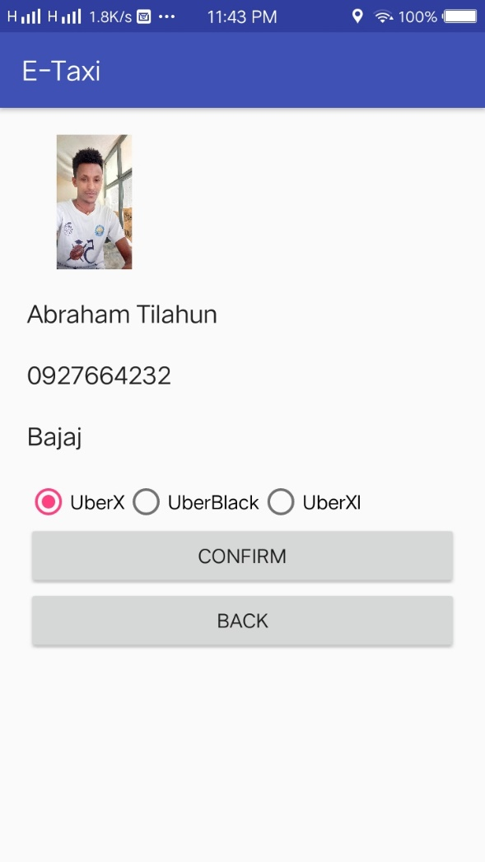
personal profile

Slide 8
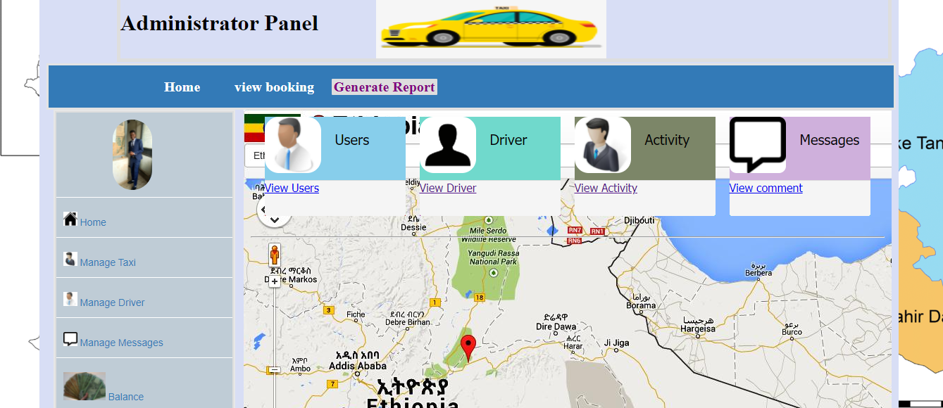

Slide 9
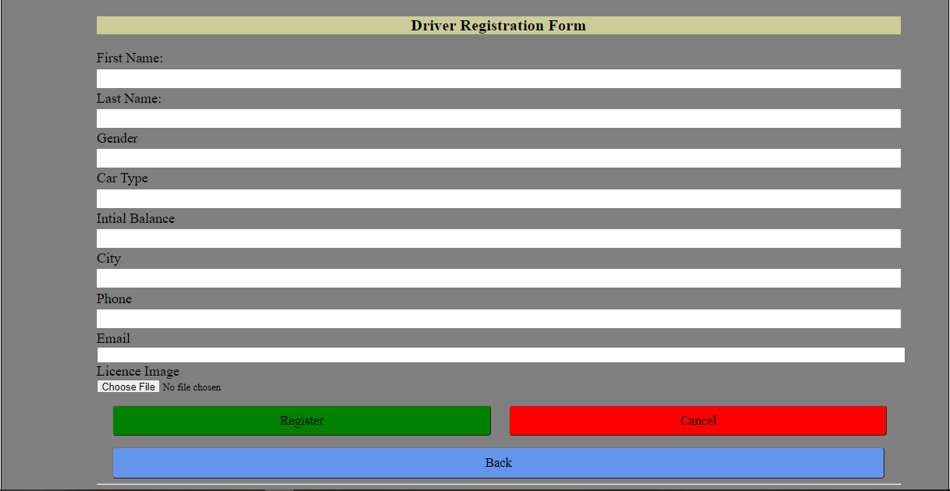

Slide 10
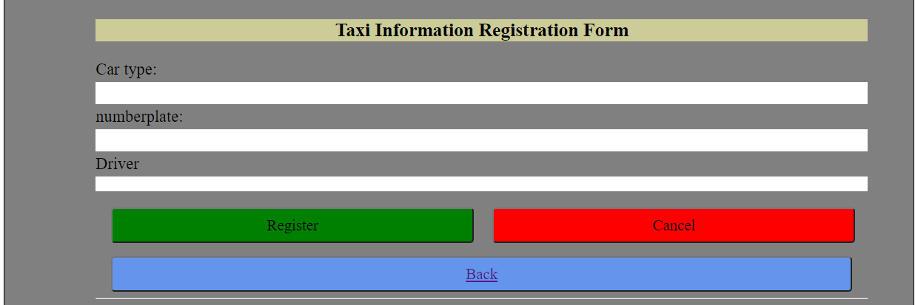

Slide 11
Thank you for your time and patience

